Slide 1
CAR Calibration Meeting CAR Review
AP Team
Ronald Tse, Paul Ip, Balina Ling, Simy Li and Adele Fan
June 3, 2014

Slide 2
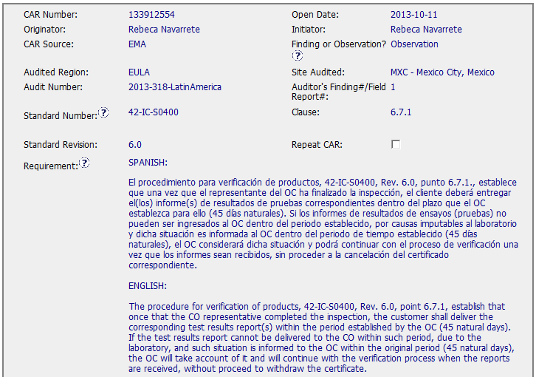
CAR# 133912554
Good practice to describe it in English also.
Notes:
For the CAR# 13392770:
[CAR Review based on 00-QA-S0006 - Corrective Action Request Process]
This CAR is related the lab testing staff used the non-calibration equipment to conduct the test.

Slide 3
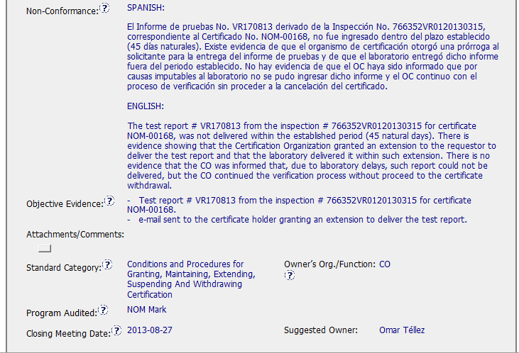
CAR# 133912554
Good practice to describe it in English also.
Notes:
For the CAR# 13392770:
[CAR Review based on 00-QA-S0006 - Corrective Action Request Process]
This CAR is related the lab testing staff used the non-calibration equipment to conduct the test.

Slide 4
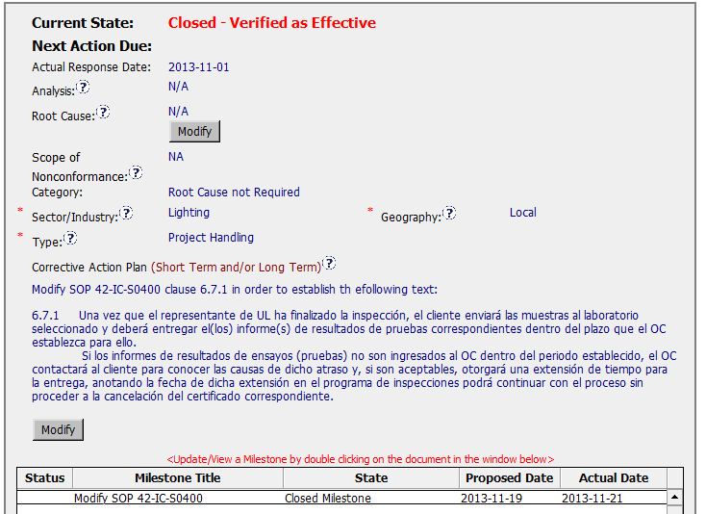
CAR# 133912554
This is an Observation CAR, It’s not required for these three fields.
Recommend to add English description also.
Will explain in the next side
[Competitiveness](C) – Root cause statement show ‘N/A’ for observation.
Notes:
For the CAR# 13392770:
[CAR Review based on 00-QA-S0006 - Corrective Action Request Process]
This CAR is related the lab testing staff used the non-calibration equipment to conduct the test.

Slide 5
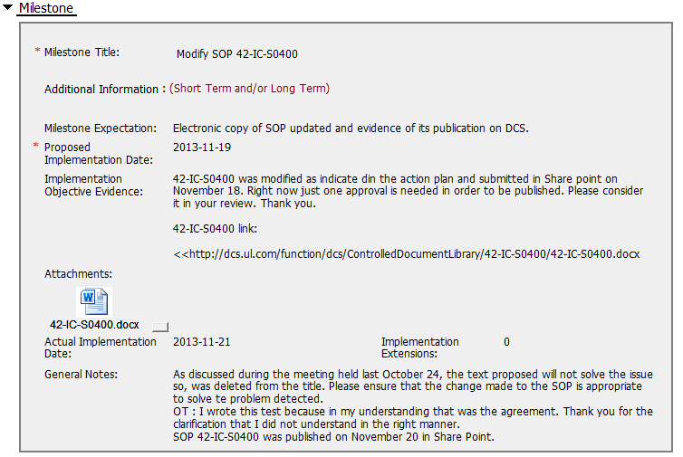
CAR# 133912554
On 11/19, the owner requested date extension from 11/19 to 11/22, and this sentence is the extension reason.
Before the CAR Admin approve the extension request, the owner submit the implementation evidence on 11/21.
Recommend to add the publish notification of DCS in the attachments area as the evidence
Notes:
For the CAR# 13392770:
[CAR Review based on 00-QA-S0006 - Corrective Action Request Process]
This CAR is related the lab testing staff used the non-calibration equipment to conduct the test.

Slide 6
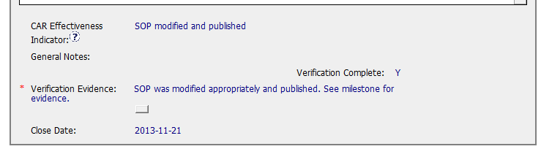
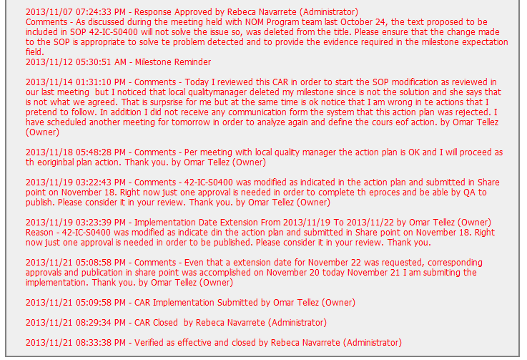
CAR# 133912554
Immediately verify observation CARs upon CAR closure.
[Integrity] (C) – Extension is within requirement(<30 days, 3 or less)
[Competitiveness](P) – Verification per requirements.
Notes:
For the CAR# 13392770:
[CAR Review based on 00-QA-S0006 - Corrective Action Request Process]
This CAR is related the lab testing staff used the non-calibration equipment to conduct the test.

Slide 7
CAR# 133912554 (Overall Comment)
One suggestion:
If the CAR is written in local language, recommend to add English description to make the CAR easily to be understood by others.
Notes:
Milestones – have final milestone for owner’s verification of effectiveness; enough time is allowed for new records to be examined
Although CAR owner self-verification is added at the last milestone, it doesn’t cover the corrective action for the failure conducting previous Management Review.
In fact, would the next round of Management Review be able to conducted on-time, it has not been addressed.
It is suggested that the verification should focus on whether the updated process and/or next round of Management Review is in place to avoid recurrence of such nonconformity.
Milestones – completed per milestone expectations
It is acceptable as Containment Action for the supporting evidence covered in the 1st milestone, i.e. Management Review Report for Year 2011 and Year 2012 [Suggest to inviting a person could read German for verification…].
However, the evidence “Attachment of the management review 2013 in milestone one. The effectiveness of the management review was reviewed by the EULA Region Quality Manager and found to be acceptable.” stated in the 2nd milestone is irrelevant while the Management Review for Year 2013 has not been conducted yet. Not sure how CAR Administrator accepts it.
In addition, for 2nd milestone, it is suggested that a statement should be provided by CAR Owner to indicate that “Recommendation for improvement” is now covered as input in the process of Management Review for Year 2011 and 2012...

